Slide 1
Greedy Algorithms

Slide 2
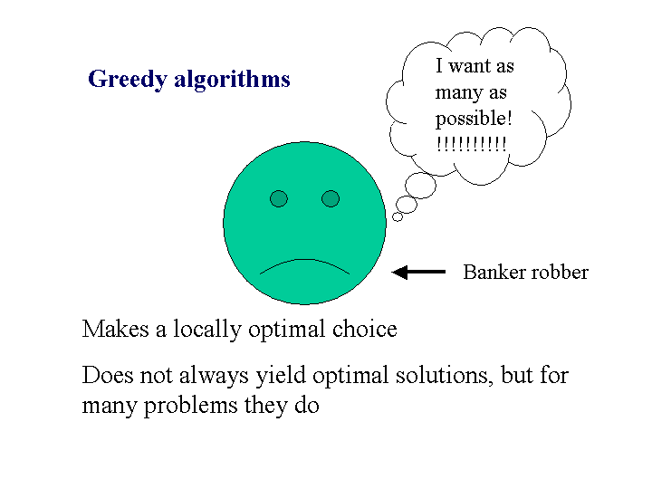

Slide 3
An activity selection problem
Problem:
  Optimal scheduling of a resource among several competing activities (scheduling rehearsal times in a music studio)
  Want to select as many mutually compatible activities as possible.

Slide 4
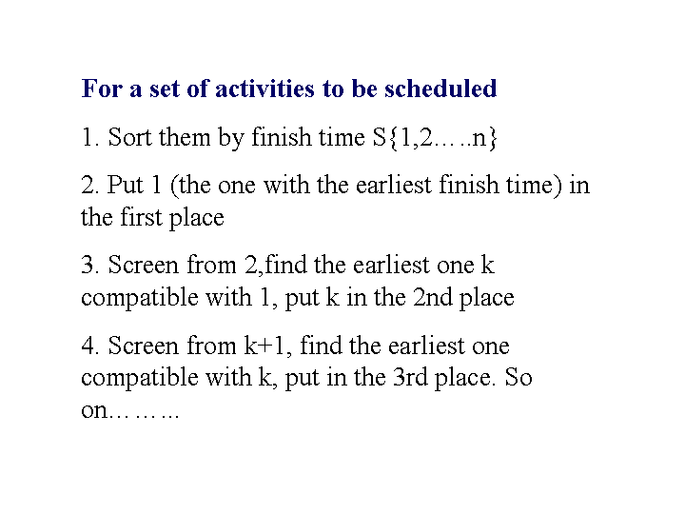

Slide 5
Problem setup
S = {1, 2, ..., n} a set of n proposed activities.
Each activity i has s_{i} a start time, and f_{i} a finish time s_{i} ≤ f_{i}.
If activity i is selected, the resource is occupied in the interval [s_{i} , f_{i}). We say i and j are compatible activities if [s_{i} , f_{i}) ∩ [s_{j} , f_{j}) = Ф

Slide 6
Greedy-Activity-Selector ( s, f )
Assume that f₁ ≤ f₂ ≤ ... ≤ f_{n}
Greedy-Activity-Selector ( s, f )
  n ← length [s]
  A ← { 1 }
  j ← 1
  for i ← 2 to n
  do if s_{i} ≥ f_{j}
  then A ← A U{ i }
  j ← i
  return A

Slide 7
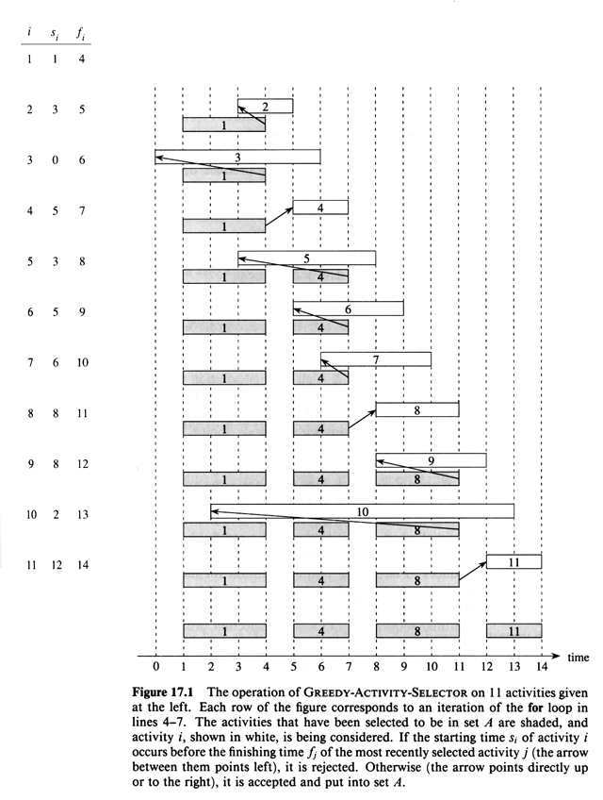

Slide 8
Example (Contd…)
The activity picked is always the first that is compatible. Greedy algorithms do not always produce optimal solutions.
Running time for sorting n activities by f_{j}
O ( n log n ) and for Greed-Activity-Selector is O ( n )

Slide 9
The 0 - 1 knapsack problem
A thief has a knapsack that holds at most W pounds.
Item i : ( v_{i}, w_{i} ) ( v = value, w = weight )
Thief must choose items to maximize the value stolen and still fit into the knapsack.
Each item must be taken or left ( 0 - 1 ).

Slide 10
Fractional knapsack problem
The setup is same as (0-1) Knapsack, but the thief can take fractions of items, rather than having to make a binary choice(0-1) for each item.

Slide 11
Contd…
Fractional: v_{i} / w_{i} is the value per pound.
Clearly you take as much of the item with the greatest value per pound
This continues until you fill the knapsack. Optimal (Greedy) algorithm takes O ( n log n ) time, as we must sort on vi / wi = di.

Slide 12
Example
W = 50 lbs. (maximum knapsack capacity)
  w₁ = 10 v₁ = 60 d₁= 6
  w₂ = 20 v₂ = 100 d₂= 5
  w₃ = 30 v₃ = 120 d₃ = 4
were d is the value density

Slide 13
Greedy approach: Take all of 1, and all of 2: v1+ v2 = 160
Optimal solution is to take all of 2 and 3: v2 + v3= 220, other solution is to take all of 1 and 3 v1+ v3 = 180. All below 50 lbs.
When solving the 0 - 1 knapsack problem, empty space lowers the effective d of the load. Thus each time an item is chosen for inclusion we must consider both i included and excluded
These are clearly overlapping sub-problems for different i's and so best solved by DP!

Slide 14
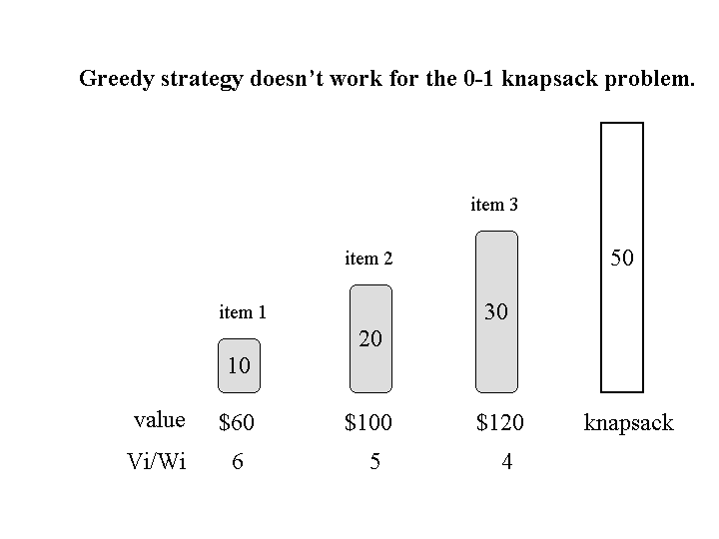

Slide 15
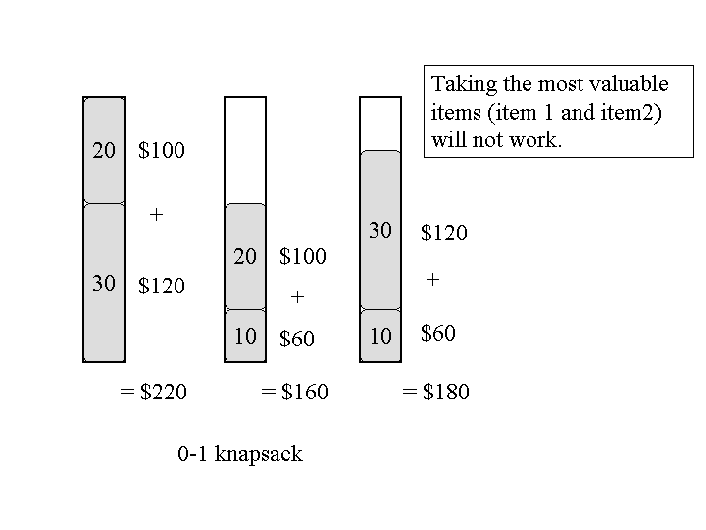

Slide 16
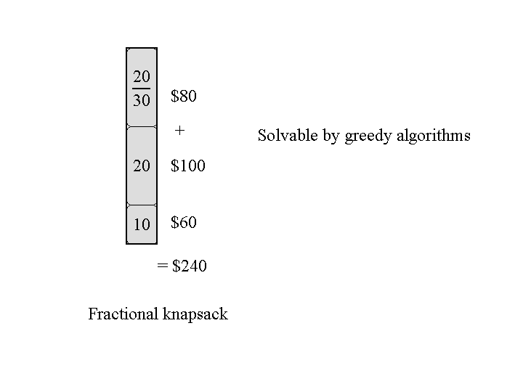

Slide 17
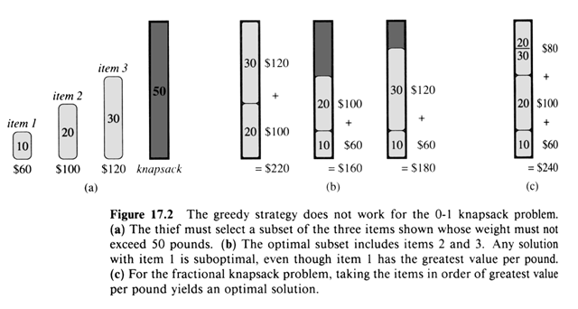

Slide 18
Huffman Codes
Effective technique for data compression
Savings of 20-90% are typical
Uses a table of frequencies of occurrences of characters to build up an optimal way of representing each character as a binary string

Slide 19
Examples of Different Binary Encodings
Fixed length code
  Each character in file represented by a different fixed length code
  Length of encoded file depends only on the number of characters in the file
  Example
    6 character alphabet (3 bit code), 25,000 character file takes 75,000 bits

Slide 20
Binary encodings continued
If shorter binary strings are used for more frequent characters, a shorter encoding could be used
Variable length encoding uses 58,000 bits
A B C D E F
Frequency (in thousands) 5 2 3 4 10 1
Fixed-length codeword 000 001 010 011 100 101
Variable-length codeword 111 1001 101 110 0 1000

Slide 21
Encoding and Decoding
Encoding
  substitute code for the character
Decoding
  Fixed length: take x number of characters at a time and look up character corresponding to code
  Variable length: must be able to determine when one code ends and another begins

Slide 22
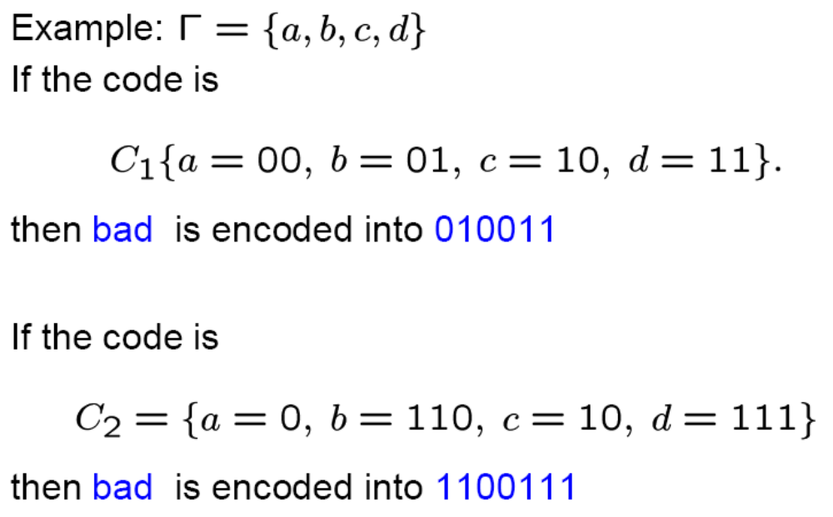
Encoding
Given a code (corresponding to some alphabet A’) and a message it is easy to encode the message. Just replace the characters by the codewords.

Slide 23
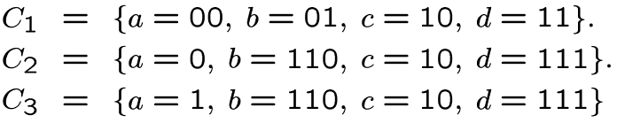
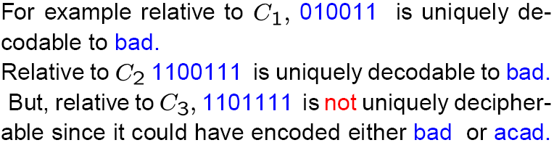
Decoding
Given an encoded message, decoding is the process of turning it back into the original message. A message is uniquely decodable if it can only be decoded in one way.

Slide 24
Prefix Codes
Each code has a unique prefix.
  0 101 100
Prefix constraint
  The prefixes of an encoding of one character cannot be equal to a complete encoding of another character
Decoding is never ambiguous
  identify the first character
  remove it from the file and repeat
  Use binary tree to represent prefix codes for easy decoding

Slide 25
Important Fact:
Every message encoded by a prefix tree code is uniquely decipherable. Since no codeword is a prefix of any other we can always find the first codeword in a message, peel it off and continue decoding.

Slide 26
Problem
Given a text (a sequence of characters) find an encoding for the characters that satisfies the prefix constraint and that minimizes the number of bits need to encode the text.

Slide 27
Binary Tree Representation of Prefix Code
An optimal code is always represented by a full binary tree, in which every non-leaf node has two children
  |C| leaves and |C|-1 internal nodes
Each leaf represents a character
A left child represents the character 0 and a right child represents the character 1.
The path from the root to the leaf represents the encoding for the leaf

Slide 28
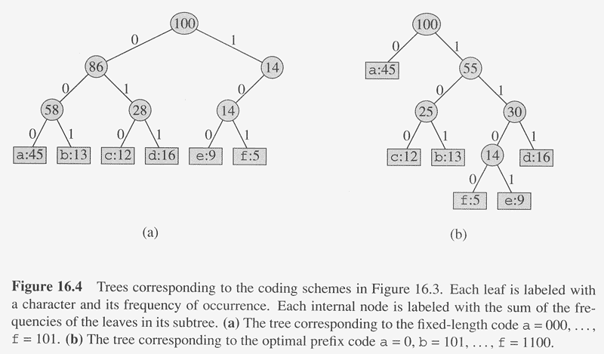
(Not optimal)

Slide 29
Characteristics of Binary Tree
Not a binary search tree
The optimal code for a file is always represented by a full binary tree in which every non-leaf node has two children.
If C is the alphabet, then a tree for the optimal prefix code has
  |C| leaves
  |C|-1 internal nodes

Slide 30
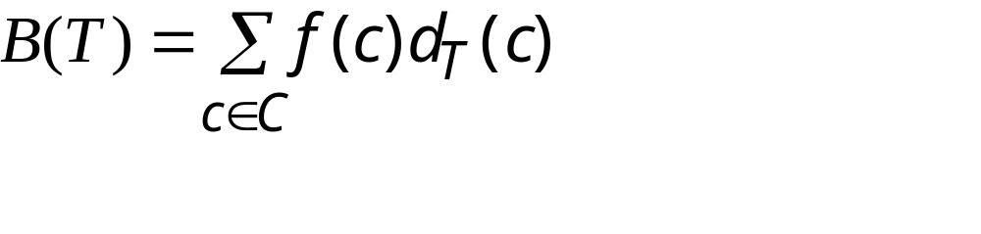
Cost of a Tree T
For each character c in the alphabet C
  let f(c) be the frequency of c in the file
  let d_{T}(c) be the depth of c in the tree
    It is also the length of the codeword. Why?
Let B(T) be the number of bits required to encode the file (called the cost of T)

Slide 31
Constructing a Huffman Code
Greedy algorithm for constructing an optimal prefix code was invented by Huffman
Codes constructed using the algorithm are called Huffman codes
Bottom up algorithms
  Start with a set of |C| leaves
  perform a sequence of |C|-1 merging operations

Slide 32
Huffman Codes
A widely used compression algorithm
Savings of 20% - 90%
Uses the frequency of the characters
Fixed codes versus variable-length codes:
Letter freq fixed code variable
a 45 000 0
b 13 001 101
c 12 010 100
d 16 011 111
e 9 100 1101
f 5 101 1101

Slide 33
Constructing a Huffman Tree
f:5
e:9
c:12
b:13
d:16
a:45

Slide 34
Constructing a Huffman Tree
c:12
b:13
14
d:16
a:45
0
1
f:5
e:9

Slide 35
Constructing a Huffman Tree
14
d:16
25
a:45
0
1
0
1
f:5
e:9
c:12
b:13

Slide 36
Constructing a Huffman Tree
25
30
a:45
0
1
0
1
c:12
b:13
14
d:16
0
1
f:5
e:9

Slide 37
Constructing a Huffman Tree
a:45
55
0
1
25
30
0
1
0
1
c:12
b:13
14
d:16
0
1
f:5
e:9

Slide 38
Constructing a Huffman Tree
100
0
1
a:45
55
0
1
25
30
0
1
0
1
c:12
b:13
14
d:16
0
1
f:5
e:9

Slide 39
HUFFMAN(C)
1 n ← |C|
2 Q ← C ; Characters are in a priority queue
3 for i ←1 to n-1
4 do z ← ALLOCATE-NODE()
5 x ← left[z] ← EXTRACT-MIN(Q)
6 y ← right[z] ← EXTRACT-MIN(Q)
7 f[z] ← f[x] + f[y]
8 INSERT(Q,z)
9 return EXTRACT-MIN(Q)

Slide 40
Running Time of Huffman’s Algorithm
Assume Q implemented as a binary heap
Assume n characters in alphabet

